Slide 1

Let’s start with Allah Yaar
Bs in Computer Science

Slide 2
Systems Life Cycle
The Systems Life Cycle (also known as the System Development Life Cycle or SDLC) is a structured approach used to develop, implement, and manage information systems or software systems. This cycle provides a methodical way to plan, design, implement, test, deploy, and maintain a system, ensuring it meets requirements, works efficiently, and is sustainable over time.

Slide 3
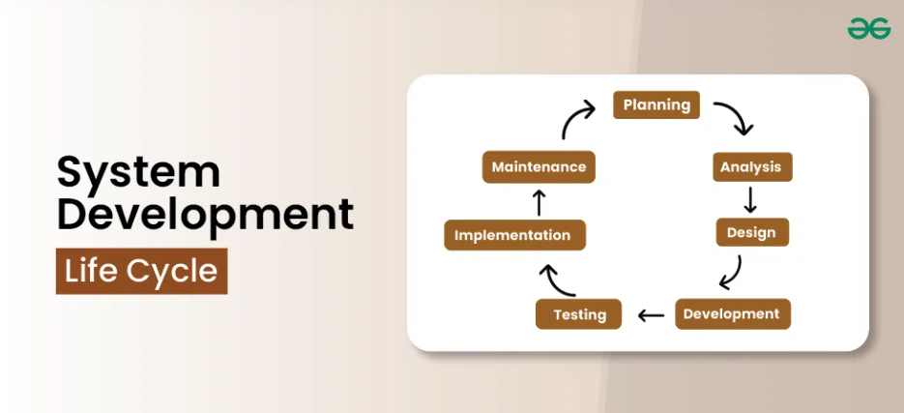
Systems Life Cycle

Slide 4
Systems Life Cycle
Analysis
The analysis stage is where everything begins. The goal is to understand what the new system needs to accomplish, how it will solve existing problems, and what requirements it must meet.
Identifying the Problem
Gathering Requirements
Feasibility Study
Requirements Specification

Slide 5
Systems Life Cycle
Identifying the Problem: The first step is to pinpoint the issue that the new system is meant to address. This could involve inefficiencies in current processes, unmet user needs, or the need for new capabilities.
Gathering Requirements: Analysts gather detailed requirements from users and stakeholders. This can involve interviews, surveys, and reviewing any existing documentation to understand what users expect and what functions the system must perform.
Feasibility Study: A feasibility study is conducted to determine if the project is viable. It evaluates technical feasibility (if the technology is available), economic feasibility (if the project fits the budget), and operational feasibility (if the solution will effectively solve the problem).

Slide 6
Systems Life Cycle
Requirements Specification: After gathering requirements, analysts create a detailed requirements specification document. This serves as a blueprint, ensuring all stakeholders are aligned and that the system will meet user expectations.

Slide 7
Systems Life Cycle
Design
The design stage is where the detailed framework and architecture of the system are planned out, based on the requirements identified in the analysis phase.
System Architecture Design
Database Design
User Interface Design
Process Design
Security and Backup Plan

Slide 8
Systems Life Cycle
System Architecture Design: This involves designing the overall structure, such as which hardware, software, and network components are needed.
Database Design: If the system requires data storage, the design includes creating the structure of databases, including tables, fields, relationships, and data flow.
User Interface Design: The system’s user interface (UI) is designed to ensure users will have an intuitive experience. This includes layout, menus, navigation, and accessibility considerations.

Slide 9
Systems Life Cycle
Process Design: Involves detailing the workflows within the system—how information will flow and be processed from one stage to another.
Security and Backup Plan: Includes planning for data security measures, access control, and backup solutions to protect system integrity.

Slide 10
Systems Life Cycle
Development
The development stage is where the actual creation and coding of the system take place, guided by the design specifications.
Coding
System Integration
Version Control

Slide 11
Systems Life Cycle
Coding: Programmers write the code, turning design specifications into a working system. They may use various programming languages, frameworks, and tools suited to the system’s needs.
System Integration: Once individual components are coded, they need to be integrated into a single, cohesive system. This process includes making sure that different modules work together and function as expected.
Version Control: Development often involves using version control systems to keep track of changes, manage different versions, and ensure the integrity of the code throughout development.

Slide 12
Systems Life Cycle
Testing
In the testing phase, the system is rigorously tested to identify and correct any errors before deployment.
Unit Testing
Integration Testing
System Testing
User Acceptance Testing (UAT)
Bug Fixing

Slide 13
Systems Life Cycle
Unit Testing: This tests individual components or modules to verify that each one works correctly on its own.
Integration Testing: After unit testing, integration testing checks how modules work together and ensures that data flows correctly between components.
System Testing: The complete system is tested as a whole to validate it against the initial requirements. This testing often involves simulating real-world scenarios to ensure the system performs as expected.

Slide 14
Systems Life Cycle
User Acceptance Testing (UAT): UAT is conducted with end-users to ensure that the system meets their needs. Users test the system to verify that it’s intuitive, useful, and meets their requirements before the system goes live.
Bug Fixing: Any issues discovered during testing are documented, fixed, and retested to ensure the system operates smoothly.

Slide 15
Systems Life Cycle
Implementation
In the implementation phase, the system is installed, configured, and made operational in its real environment.
Training Users
Data Migration
Deployment
Support and Troubleshooting

Slide 16
Systems Life Cycle
Training Users: Training sessions or manuals are provided to end-users to help them understand how to use the new system effectively.
Data Migration: If necessary, data from old systems is migrated to the new system. This involves transferring data, cleaning it, and ensuring it’s correctly formatted.
Deployment: The system is officially rolled out for use. This may be a full launch or a phased approach, depending on the system’s complexity and the organization’s readiness.
Support and Troubleshooting: Initial support is often provided to handle any immediate issues users encounter as they start using the system.

Slide 17
Systems Life Cycle
Documentation
Documentation is essential throughout the life cycle, as it helps maintain the system, facilitates future updates, and supports user understanding.
User Documentation
System Documentation
Maintenance Plans

Slide 18
Systems Life Cycle
User Documentation: Guides and manuals are created for users to help them understand how to operate the system. This may include quick reference guides, detailed manuals, FAQs, and online help.
System Documentation: Technical documentation is created for developers and administrators, detailing the system architecture, codebase, data structures, and any configurations. This documentation is invaluable for troubleshooting, future maintenance, and updates.
Maintenance Plans: Documentation often includes plans for maintaining the system, detailing processes for regular updates, security checks, and backup procedures.

Slide 19
Systems Life Cycle
Evaluation
The evaluation stage assesses the effectiveness and success of the system once it has been in use for some time.
Performance Review
User Feedback
Cost-Benefit Analysis
Future Recommendations

Slide 20
Systems Life Cycle
Performance Review: Evaluates if the system meets the initial objectives and requirements, analyzing aspects such as speed, reliability, and accuracy.
User Feedback: Gathers feedback from users to understand their satisfaction level and any issues they’ve encountered. Feedback helps identify potential improvements.
Cost-Benefit Analysis: Compares the costs of development, implementation, and maintenance against the benefits achieved. This analysis helps determine the system’s return on investment (ROI).
Future Recommendations: Based on feedback and performance reviews, the evaluation phase may lead to recommendations for improvements, additional features, or the system’s next version.

Slide 21
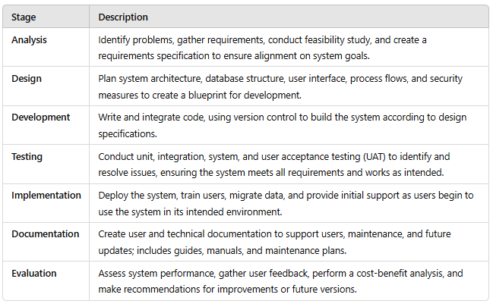
Summary Table

